Slide 1
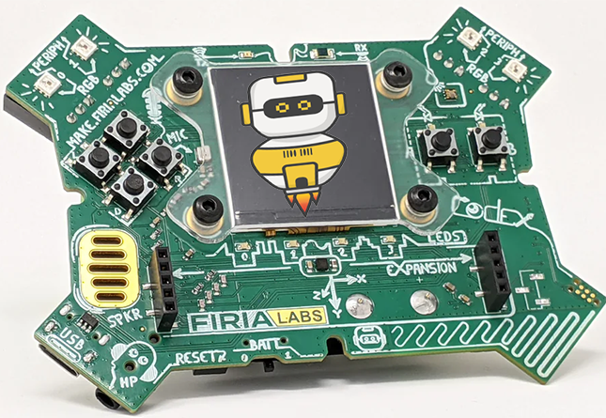
CodeX Unit 1 Remix
Create your own project based on Missions 3-5

Slide 2
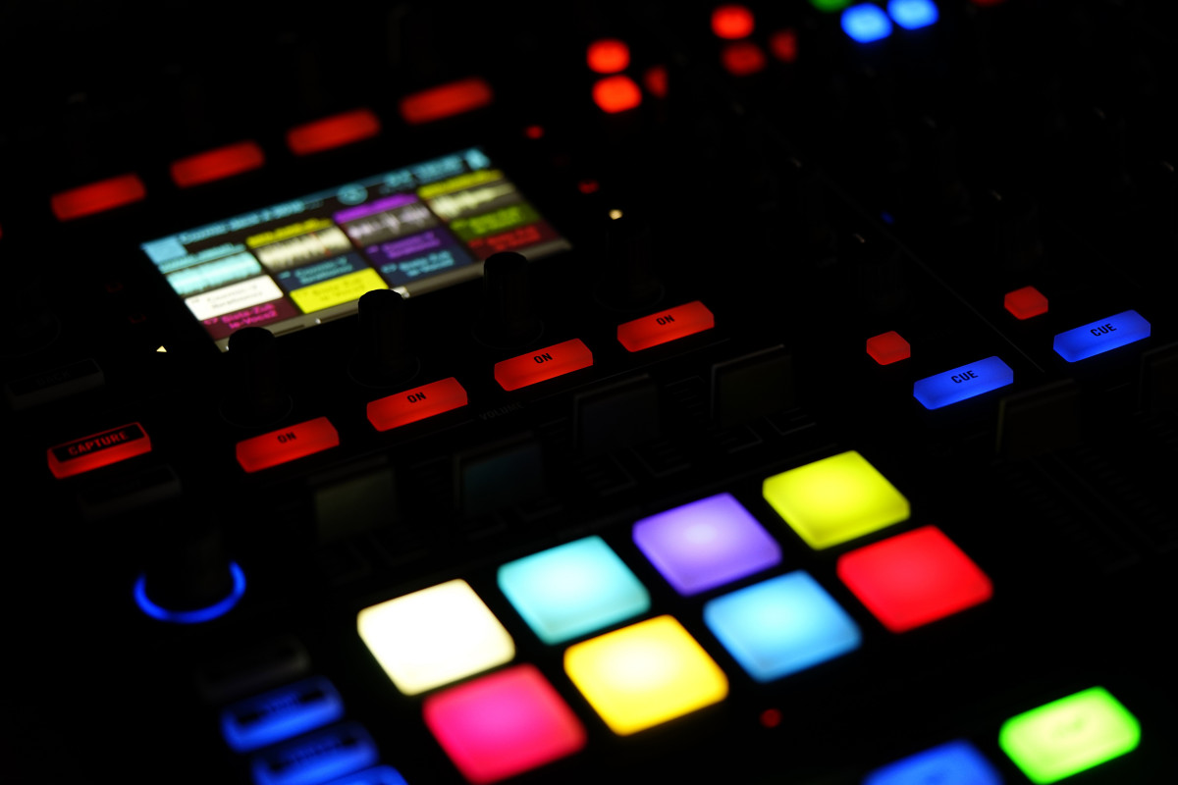
Have you heard of music remixes?
It is when someone takes parts of a song, or several songs, and uses them to create something original.
You can combine two or more songs as part of a remix.
Something new is created by combining parts of songs and adding new music with the parts.

Slide 3
Time for a coding remix!
You can do the same thing with your mission projects!
A new program is created by adding new code and parts of code from programs you already created.
Or use a similar idea in a different way.

Slide 4
Project Remix
Creating a remix will let you:
Improve your skills and practice the concepts from the mission.
Be creative.
Remember code from earlier programs and missions.
Work with other students.
Design an original program and write the code all on your own.

Slide 5
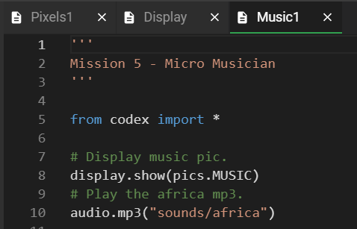
Step #1
Getting Started
Open your programs from Mission 3, Mission 4 and Mission 5:
Pixels1_functions
Display_functions
Music1
Review what each program does.
Review the concepts and skills used.
Notes:
.

Slide 6
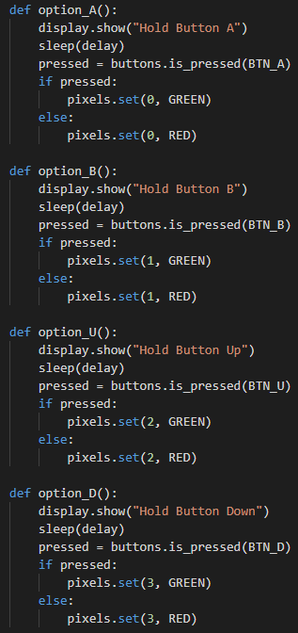
Step #1
For Example:
The Mission 4 Project:
The final project played a game by asking the user to press buttons in order in under 1 second.
Concepts and skills used:
Print text strings
Program a button press using if:
Convert between string and integer

Slide 7
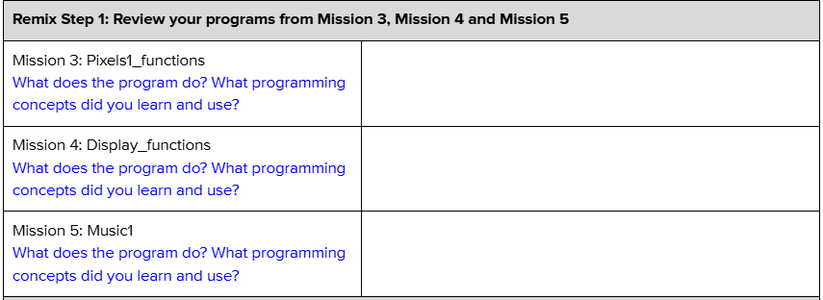
Step #1
DO THIS:
Fill out the information in the Planning Guide for Step 1

Slide 8
Step #2
Brainstorm ideas
Read through remix ideas for each mission.
Read through Unit 1 Remix suggestions.
You can use any of these ideas or come up with your own.

Slide 9
Step #2 Remix Ideas
Mission 3 Remix Ideas
MILD: Select an RGB color for all four pixels and display an image. After a short sleep(delay), select a different RGB color and image. Repeat as many times as you want. Refer to “Using RGB values” for help.
MEDIUM: Light all pixels with an RGB color. Then turn off the pixels and display an image. Then clear the screen and light the pixels with another RGB color. Repeat as many times as you want.
SPICY: Use one of the ideas from Mild or Medium, but instead of using an RGB color that you choose, use random colors. Use the Page 8 challenge for help.

Slide 10
Step #2 Remix Ideas
Mission 4 Remix Ideas
MILD: Add images to the code. When a pixel turns green, display an image like a happy face. Then the pixel turns red, display a different image.
MEDIUM: Use images instead of printed instructions. There are arrow images available. Display an arrow and check for the correct button. For example, the north arrow points up and can be used for BTN_U.
SPICY: Use a color of pixel to indicate which button to press. For example, if a pixel turns RED, press BTN_U. If a pixel turns BLUE, press BTN_D. And so forth. You can use six colors and all six buttons. Display an image (like a sad face) if they are incorrect. You may want to include a set of print statements at the beginning as instructions that tell the button and color combination.
Think of your own creative project with buttons, pixels and images.

Slide 11
Step #2 Remix Ideas
Mission 5 Remix Ideas
Create a string variable for the audio file and use it in your code
Program several buttons to play music
Before the music plays, add one or more of these:
Turn on the color of the pixels
Display an image
Fill the screen with a color

Slide 12
Step #2 Remix Ideas
Mild
Create a game like “Display” but use a audio prompt for which button to press. Or use an the audio “yes” and “no” to indicate if the user is correct.
Medium
Program each button to do a different task. For example, BTN-A could light pixels and display an image. BTN_B could display an image and play audio. BTN_U could cause pixels to blink random colors, and so forth.

Slide 13
Step #2 Remix Ideas
Medium
Create turn signals for a bicycle. Press BTN_L to turn left and BTN_R to turn right. Blink the pixels to indicate the turn, and use an audio file to say the direction you are turning.
Spicy
Combine the two mild remixes into one program – audio prompt for the button and audio file for correct or wrong. Also, add print statements at the beginning for an intro and a print statement at the end.

Slide 14
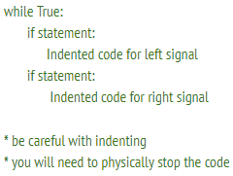
Step #2 Remix Ideas
Spicy
Program at the buttons to display a short poem or nursery rhyme and play an audio file.
EXTENSION:
Use a while True: loop to repeat the code so you don’t have to start the program over every time. You will learn more about this in Mission 6.

Slide 15
Step #2
Brainstorm ideas
Read through remix suggestions.
Use the suggestions –or–
Use your creativity to come up with your own idea for a project.
Decide with your partner what project you will do.
DO THIS:
Fill out the information in the Planning Guide for Step #2

Slide 16
Step #3
Make a plan
What variables will you need? What will you use them for?
What will you program the buttons to do?
What will pixels will you light up? What color? When?
Will you use audio files? If so, when?
What text will you show or print?
What are some functions you can define and use?

Slide 17
Step #3
Make a plan
DO THIS:
Fill out the information in the Planning Guide for Step #3
Add to the Planning Guide with more information, as needed.
NOTE: You can modify your plan as you begin to program. You may come across more functions to create, LED uses, and more as you go.
You do not need to revise Step 3 while you work.

Slide 18
Step #3
Make a plan
DO THIS:
Use a piece of paper to write an algorithm for your project:
What happens first?
What happens next?
This algorithm will help you get started.
What do you need to import?
Are there functions you can start with?
What happens first in the main program?
What will happen in the button presses?

Slide 19
Step #4
Code your project
IMPORTANT: In CodeSpace, go to the sandbox.
Start a new file and give it a descriptive name (Remix1).
You can leave other programs open and use them as a guide.
Import your modules.
Define your variables.
Write functions near the top of your code.
Write function calls and other instructions in the main program.
Write your code a little bit at a time, testing frequently.

Slide 20
Step #4
Stop and test frequently!
Don’t try to write all the code at one time.
Think about the steps:
Just get one thing to work, then move on.
Step by step!
Mistakes happen, so find them early.
Type just a few lines of code and then run the program.
If there is an error, fix it before continuing. Ask others for help.
Use your other programs and classmates for help.

Slide 21
Step #4
Documentation!
Make sure your code is readable by adding blank lines.
Add comments to sections of your code that explain what they do.

Slide 22
Step #5
Get feedback and Revise
After you code is finished, show the program to other students.
What do they think? Have them fill out the feedback form on your Planning Guide.
The Planning Guide has space for two people to give feedback. The feedback can come from two peers or one peer and yourself.
Use the peer reviews to modify your code and make your project even better

Slide 23
And now you have your own remix!
Congratulations!
By completing this remix you have:
learned more about programming,
practiced the skills and concepts from the missions,
been thinking! And problem solving and much more!

Slide 24
Mission Reflection
Wow! Great job!
Share your project with your friends!
Run projects from other students.
Complete the Post-Remix Reflection in the Planning Guide.

